Slide 1
Chapter 3
The Relational Data Model and Relational Database Constraints

Slide 2
Chapter 3 Outline
The Relational Data Model and
Relational Database Constraints
Relational Model Constraints
and Relational Database Schemas
Update Operations, Transactions,
and Dealing with Constraint Violations

Slide 3
The Relational Data Model
Relational model
  First commercial implementations available in early 1980s
  Has been implemented in a large number of commercial system
Hierarchical and network models
  Preceded the relational model

Slide 4
Relational Model Concepts
Represents data as a collection of relations
Table of values
  Row
    Represents a collection of related data values
    Fact that typically corresponds to a real-world entity or relationship
    Tuple
  Table name and column names
    Interpret the meaning of the values in each row attribute

Slide 5
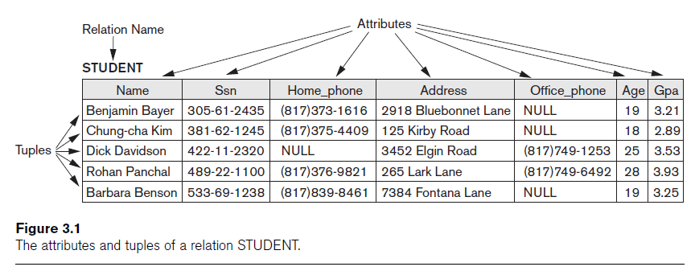
Relational Model Concepts (cont’d.)

Slide 6
Domains, Attributes, Tuples, and Relations
Domain D
  Set of atomic values
Atomic
  Each value indivisible
Specifying a domain
  Data type specified for each domain
Notes:
Domain : e.g. Major_type XXXNNNN ,, Name: set of name of persons ,Grade : possible values : 0-100

Slide 7
Domains, Attributes, Tuples, and Relations (cont’d.)
Relation schema R
  Denoted by R(A₁, A₂, ...,A_{n})
  Made up of a relation name R and a list of attributes, A₁, A₂, ..., A_{n}
Attribute A_{i}
  Name of a role played by some domain D in the relation schema R
Degree (or arity) of a relation
  Number of attributes n of its relation schema

Slide 8
Domains, Attributes, Tuples, and Relations (cont’d.)
Relation (or relation state)
  Set of n-tuples r = {t₁, t₂, ..., t_{m}}
  Each n-tuple t
    Ordered list of n values t =<v₁, v₂, ..., v_{n}>
    Each value v_{i}, 1 ≤ i ≤ n, is an element of dom(A_{i}) or is a special NULL value

Slide 9
Domains, Attributes, Tuples, and Relations (cont’d.)
Relation (or relation state) r(R) : a set of tuples
  Mathematical relation of degree n on the domains dom(A₁), dom(A₂), ..., dom(A_{n})
  Subset of the Cartesian product of the domains (assuming that all domains are finite) that define R:
    r(R) ⊆ (dom(A₁) × dom(A₂) × ... × dom(A_{n}))
Notes:
The Cartesian product specifies all possible combinations of values from the underlying domains.

Slide 10
Domains, Attributes, Tuples, and Relations (cont’d.)
Cardinality
  Total number of values in domain
Current relation state
  Relation state at a given time
  Reflects only the valid tuples that represent a particular state of the real world
Attribute names
  Indicate different roles, or interpretations, for the domain

Slide 11
Characteristics of Relations
Ordering of tuples in a relation
  Relation defined as a set of tuples
  Elements have no order among them
Ordering of values within a tuple and an alternative definition of a relation
  Order of attributes and values is not that important
  As long as correspondence between attributes and values maintained
Notes:
Order is not important among the tuples.

Slide 12
Characteristics of Relations (cont’d.)
Alternative definition of a relation
  Tuple considered as a set of (<attribute>, <value>) pairs
  Each pair gives the value of the mapping from an attribute A_{i} to a value v_{i} from dom(A_{i})
Use the first definition of relation
  Attributes and the values within tuples are ordered
  Simpler notation

Slide 13
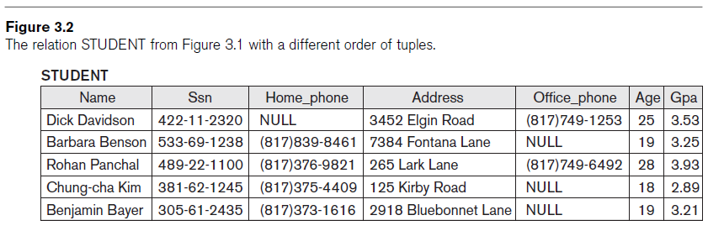
Characteristics of Relations (cont’d.)
Notes:
The relation STUDENT from Figure 3.1 with a different order of tuples.
The order of tuples are not Important.

Slide 14
Characteristics of Relations (cont’d.)
Values and NULLs in tuples
  Each value in a tuple is atomic
  Flat relational model
    Composite and multivalued attributes not allowed
    First normal form assumption!
  Multivalued attributes
    Must be represented by separate relations
  Composite attributes (e. g. fname, lname, or address)
    Represented only by simple component attributes in basic relational model
Notes:
Multivalued attributes (e. g. Children or Dependents)

Slide 15
Characteristics of Relations (cont’d.)
NULL values
  Represent the values of attributes that may be unknown or may not apply to a tuple
  Meanings for NULL values
    Value unknown
    Value exists but is not available (e.g. grade)
    Attribute does not apply to this tuple (also known as value undefined)

Slide 16
Characteristics of Relations (cont’d.)
Interpretation (meaning) of a relation
  Assertion
    Each tuple in the relation is a fact or a particular instance of the assertion
      For example, the schema of the STUDENT relation of Figure 3.1 asserts that, in general, a student entity has a Name, Ssn, Home_phone, Address, Office_phone, Age, and Gpa
  Predicate
    Values in each tuple interpreted as values that satisfy predicate
      For example, the predicate STUDENT (Name, Ssn, ...) is true for the five tuples in relation STUDENT of Figure 3.1

Slide 17
Relational Model Notation
Relation schema R of degree n
  Denoted by R(A₁, A₂, ..., A_{n})
Uppercase letters Q, R, S
  Denote relation names
Lowercase letters q, r, s
  Denote relation states
Letters t, u, v
  Denote tuples
Notes:
Degree = the number of attributes

Slide 18
Relational Model Notation
Name of a relation schema: STUDENT
  Indicates the current set of tuples in that relation
Notation: STUDENT(Name, Ssn, ...)
  Refers only to relation schema
Attribute A can be qualified with the relation name R to which it belongs
  Using the dot notation R.A

Slide 19
Relational Model Notation
n-tuple t in a relation r(R)
  Denoted by t = <v₁, v₂, ..., v_{n}>
  v_{i} is the value corresponding to attribute A_{i}
Component values of tuples:
  t[A_{i}] and t.A_{i} refer to the value v_{i} in t for attribute A_{i}
  t[A_{u}, A_{w}, ..., A_{z}] and t.(A_{u}, A_{w}, ..., A_{z}) refer to the subtuple of values <v_{u}, v_{w}, ..., v_{z}> from t corresponding to the attributes specified in the list
Notes:
e.g. (Name, ID, SSn) values (“James”,1010,”122-232-2122”)

Slide 20
Relational Model Constraints
Constraints
  Restrictions on the actual values in a database state
  Derived from the rules in the miniworld that the database represents

Slide 21
Relational Model Constraints (cont’d.)
Schema-based constraints or explicit constraints
  Can be directly expressed in schemas of the data model
Application-based or semantic constraints or business rules
  Cannot be directly expressed in schemas
  Expressed and enforced by application program
Notes:
Database-level constraints vs. application-level constraints

Slide 22
Domain Constraints
Typically include:
  Numeric data types for integers and real numbers
  Characters
  Booleans
  Fixed-length strings
  Variable-length strings
  Date, time, timestamp
  Money
  Other special data types

Slide 23
Key Constraints and Constraints on NULL Values
Key are very important part of Relational database.
Keys are used to establish and identify relation between tables.
Keys also ensure that each record within a table can be uniquely identified by combination of one or more attribute within a relation.

Slide 24
Key Constraints and Constraints on NULL Values
No two tuples can have the same combination of values for all their attributes.
Superkey
  Super Key is defined as a set of attributes within a table that uniquely identifies each record within a table.
  Super Key is a superset of Candidate key.
Notes:
All the possibilities

Slide 25
Key Constraints and Constraints on NULL Values (cont’d.)
Candidate key
  Candidate key is an attribute or combination of attributes in a table that can uniquely identify any record without referring to any other data.
  Each table may have one or more candidate keys
  Candidate key is a subset of Superkey (minimal super key).

Slide 26
Key Constraints and Constraints on NULL Values (cont’d.)
Primary key of the relation
  Designated among candidate keys
  Underline attribute
Other candidate keys are designated as unique keys

Slide 27
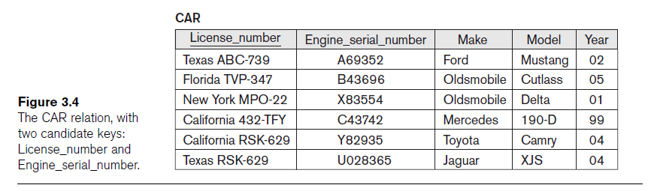
Key Constraints and Constraints on NULL Values (cont’d.)
Notes:
The CAR relation, with two candidate keys : License_number and Engine_serial_number

Slide 28
Integrity Constraint (IC)
An integrity constraint (IC) describes conditions that every legal instance of a relation must satisfy.
  Inserts/deletes/updates that violate IC's are disallowed.
  Can be used to ensure application semantics (e.g. Eid is a key), or prevent inconsistencies (e.g. name has to be a string, age must be < 200)
Types of IC's
  Domain constrains and NOT NULL constraints
  Primary key constrains and foreign key constraints
  general constrains (e. g. enum)

Slide 29
Relational Databases and Relational Database Schemas
Relational database schema S
  Set of relation schemas S = {R₁, R₂, ..., R_{m}}
  Set of integrity constraints IC
Relational database state
  Set of relation states DB = {r₁, r₂, ..., r_{m}}
  Each r_{i} is a state of R_{i} and such that the r_{i} relation states satisfy integrity constraints specified in IC

Slide 30
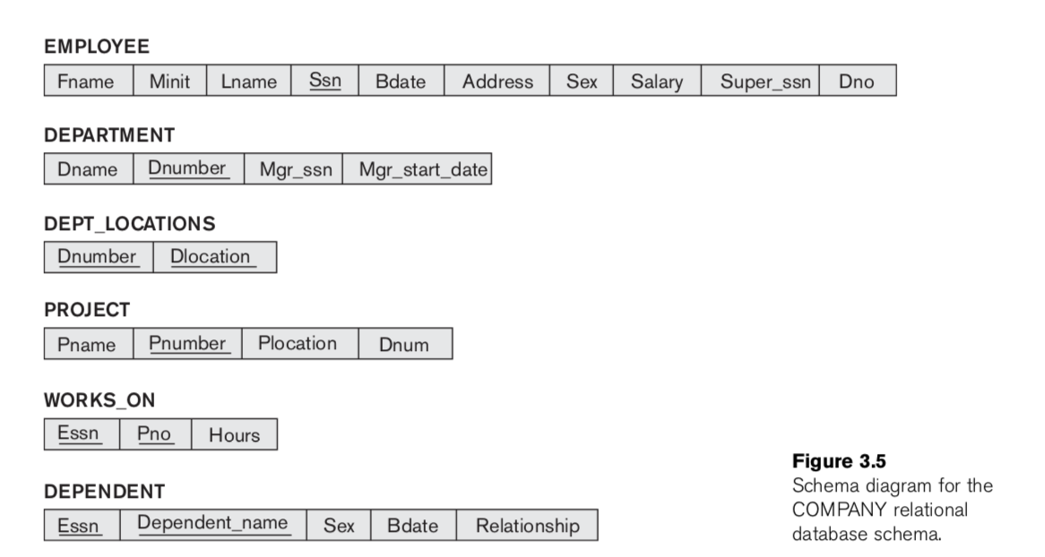
Relational database schema
COMPANY = {EMPLOYEE, DEPARTMENT, DEPT_LOCATIONS, PROJECT, WORKS_ON, DEPENDENT}

Slide 31
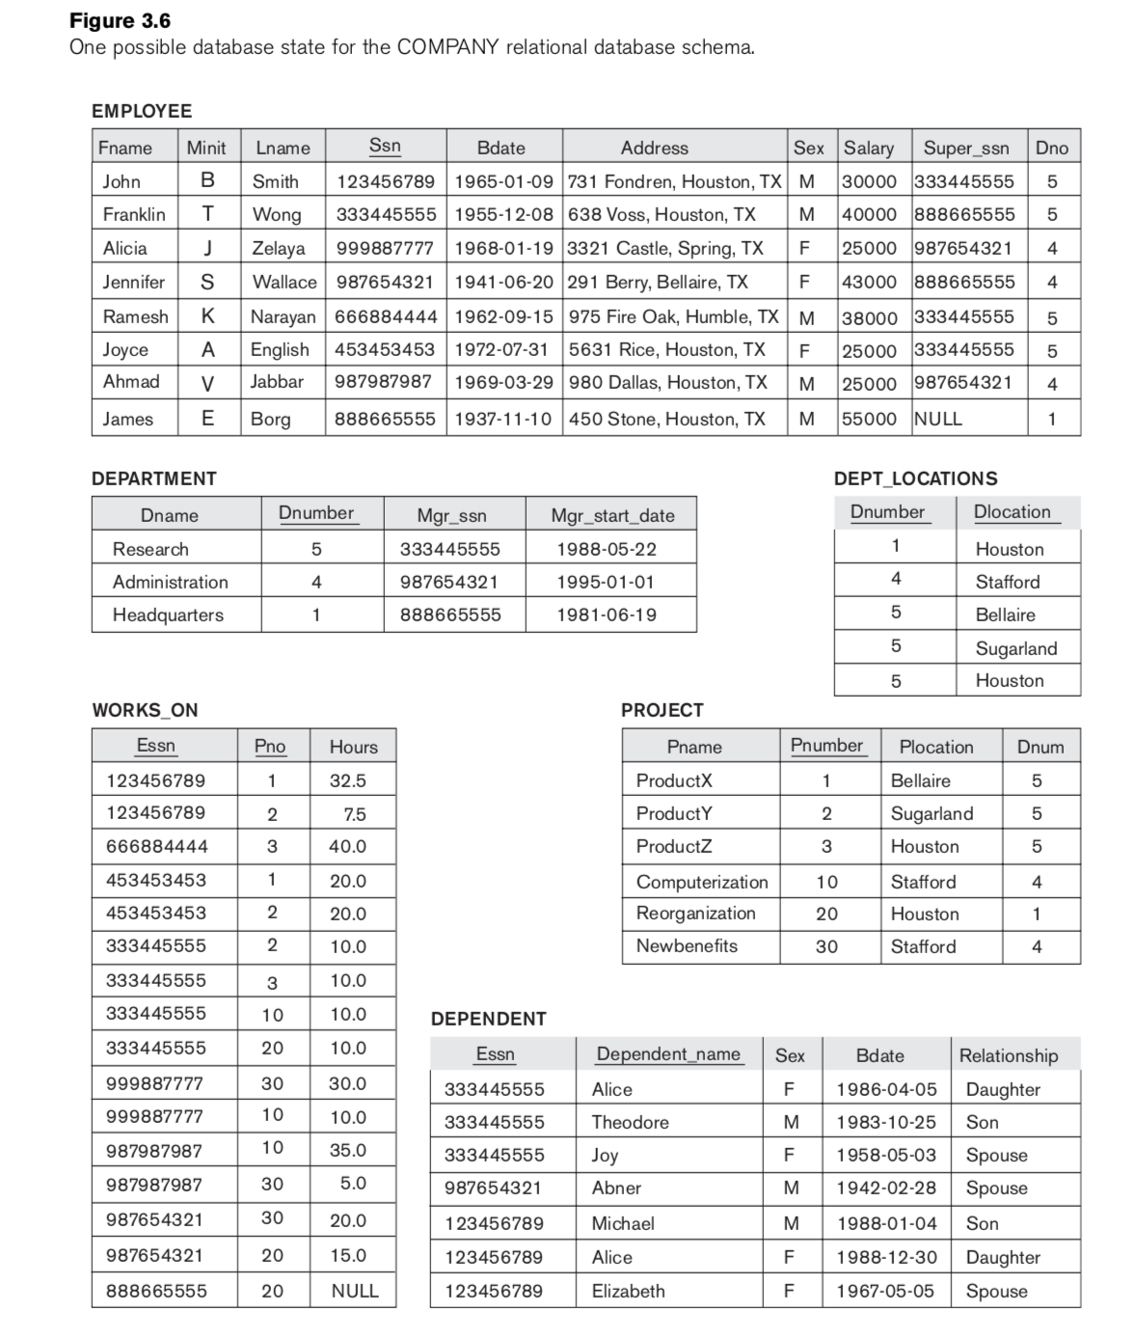
One possible state
for the COMPANY
relational database schema
Notes:
One possible state for the COMPANY relational database schema

Slide 32
Relational Databases and Relational Database Schemas (cont’d.)
Invalid state
  Does not obey all the integrity constraints
Valid state
  Satisfies all the constraints in the defined set of integrity constraints IC

Slide 33
Integrity, Referential Integrity, and Foreign Keys
Entity integrity constraint
  No primary key value can be NULL
Referential integrity constraint
  Specified between two relations
  Maintains consistency among tuples in two relations

Slide 34
Integrity, Referential Integrity, and Foreign Keys (cont’d.)
Foreign key rules:
  The attributes in FK have the same domain(s) as the primary key attributes PK
  Value of FK in a tuple t₁ of the current state r₁(R₁) either occurs as a value of PK for some tuple t₂ in the current state r₂(R₂) or is NULL

Slide 35
Integrity, Referential Integrity, and Foreign Keys (cont’d.)
Diagrammatically display referential integrity constraints
  Directed arc from each foreign key to the relation it references
All integrity constraints should be specified on relational database schema

Slide 36
Other Types of Constraints
Semantic integrity constraints
  May have to be specified and enforced on a relational database
  Use triggers and assertions
  More common to check for these types of constraints within the application programs

Slide 37
Other Types of Constraints (cont’d.)
Functional dependency constraint
  Establishes a functional relationship among two sets of attributes X and Y
  Value of X determines a unique value of Y
State constraints
  Define the constraints that a valid state of the database must satisfy
Transition constraints
  Define to deal with state changes in the database

Slide 38
Update Operations, Transactions, and Dealing with Constraint Violations
Operations of the relational model can be categorized into retrievals and updates
Basic operations that change the states of relations in the database:
  Insert
  Delete
  Update (or Modify)

Slide 39
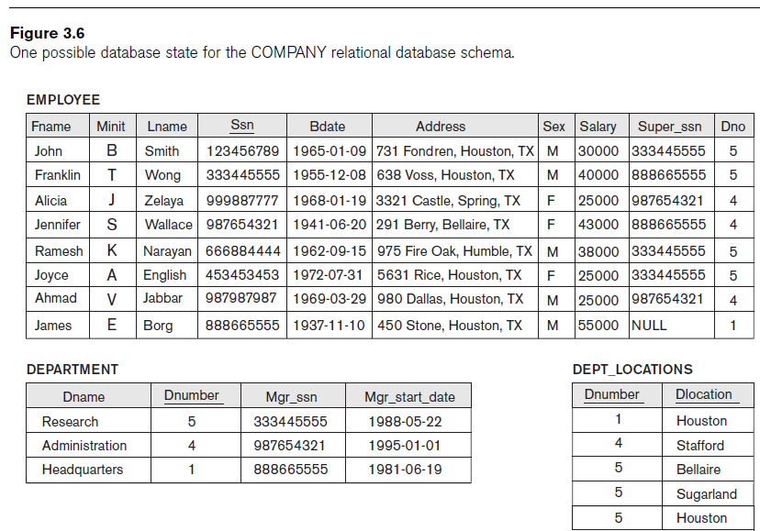
Notes:
One possible database state for the COMPANY relational database schema

Slide 40
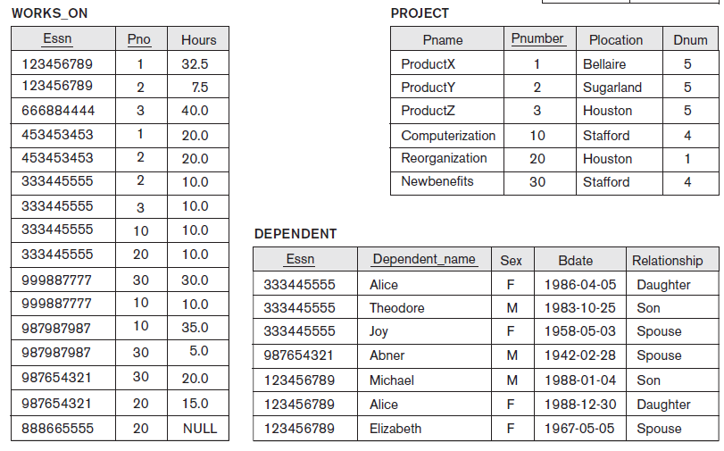
Notes:
One possible database state for the COMPANY relational database schema Cont.

Slide 41
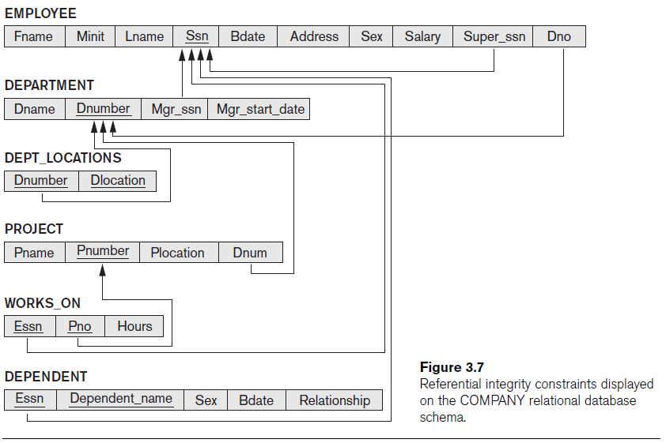
Notes:
Referential integrity constraints displayed on the COMPANY relational database schema

Slide 42
The Insert Operation
Provides a list of attribute values for a new tuple t that is to be inserted into a relation R
Can violate any of the four types of constraints
If an insertion violates one or more constraints
  Default option is to reject the insertion

Slide 43
The Delete Operation
Can violate only referential integrity
  If tuple being deleted is referenced by foreign keys from other tuples
  Restrict
    Reject the deletion
  Cascade
    Propagate the deletion by deleting tuples that reference the tuple that is being deleted
  Set null or set default
    Modify the referencing attribute values that cause the violation

Slide 44
The Update Operation
Necessary to specify a condition on attributes of relation
  Select the tuple (or tuples) to be modified
If attribute not part of a primary key nor of a foreign key
  Usually causes no problems
Updating a primary/foreign key
  Similar issues as with Insert/Delete

Slide 45
The Transaction Concept
Transaction
  Executing program
  Includes some database operations
  Must leave the database in a valid or consistent state
Online transaction processing (OLTP) systems
  Execute transactions at rates that reach several hundred per second

Slide 46
Summary
Characteristics differentiate relations from ordinary tables or files
Classify database constraints into:
  explicit schema-based constraints, and application-based constraints
Modification operations on the relational model:
  Insert, Delete, and Update

